Slide 1


Empowering Micro, Small and Medium-sized Enterprises
Report on the Study of the Demands of MSMEs in China for Empowerment
Center for Microfinance Initiatives & Networks
Renmin University of China
September 2019

Slide 2

Agenda
Introduction
Profile of questionnaire respondents
Evaluation of and empowerment in management capabilities
Evaluation of and empowerment in innovation capabilities
Demands for empowerment
Conclusion

Slide 3
I. Introduction: Why should MSMEs be empowered?
Key roles of micro, small and medium-sized enterprises (MSMEs)
MSMEs should be supported
What does empowering MSMEs mean?
Research design

Slide 4
MSMEs are important
Defining MSMEs
  Small business entities vs. large business entities
    Small business entities are not only small in size, they are fundamentally different from large entities in terms of bargaining power, reliance on other players in the value chain, and management and fundraising capabilities
    The World Bank and other international organizations refer to small business entities as:
      small and medium-sized enterprises, SMEs
      micro, small and medium-sized enterprises, MSMEs
  We are talking about smaller entities, i.e. MSMEs
  The empowerment covers not only micro enterprises, but also small and medium-sized enterprises
01

Slide 5
Classify MSMEs by headcount
Classification | The World Bank | China
Medium | 50-300 | 100-300
Small | 10-50 | 10-100
Micro | < 10 | < 10
Classify MSMEs by annual turnover
Classification | The World Bank | China
Medium | USD 3-15 million | RMB 30-300 million (USD 5-50 million)
Small | USD 0.1-3 million | RMB 5-30 million (USD 0.8-5 million)
Micro | < USD 0.1 million | < RMB 5 million (< USD 0.8 million)
Classify MSMEs by loan amount
Classification | The World Bank | Banks in China
Medium | USD 0.1-1 million | > RMB 5 million (> USD 0.8 million)
Small | USD 0.01-0.1 million | RMB 1-5 million (USD 0.15-0.8 million)
Micro | < USD 0.01 million | < RMB 1 million (< USD 0.15 million)
China: the 2017 version of classification criteria announced by MIIT, use the average numbers across industries

Slide 6
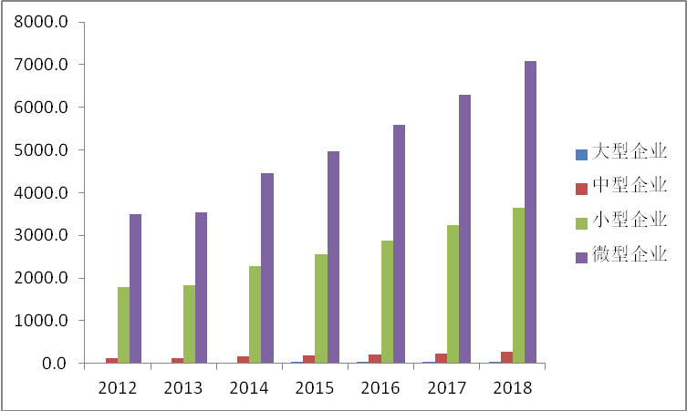
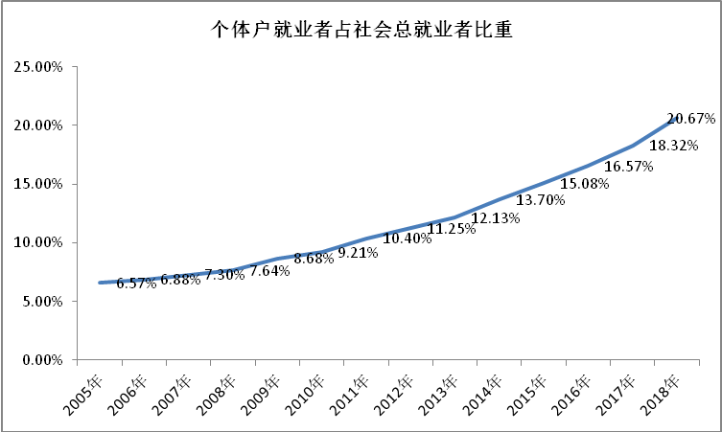
Key roles of MSMEs in China
  99.6% of businesses are MSMEs
  Contribute to nearly 76% of total employment
  Contribute to 60% of GDP
  Contribute to 50% of tax revenue
Proportion of workers in self-employed traders in total employment
Large
Medium
Small
Micro
Number of large, medium, small and micro enterprises (in ten thousands)
Proportion of workers in self-employed traders in total employment

Slide 7
    2. MSMEs need external support
Micro and small enterprises (MSEs) are relatively vulnerable
  Mostly operate at the lower end of the value chain, considerably reliant on other players in the chain
    Low bargaining power
    Working capital taken away by upstream and downstream companies
    More vulnerable to economic tremors

Slide 8
This study: MSEs mainly operate in manufacturing (38%) and wholesaling and retailing (36%)
Data from CME Survey: 21.74 and 26.2%, respectively
Product development (e.g. prototypes)
Parts production
Modular parts production
Assembling
Sales
After-sales services
Number of manufacturers
Value added
(for reference)

Slide 9
  Highly competitive industries, heavily influenced by cyclical economic fluctuations
    Data from this study shows that MSEs mainly operate in manufacturing (38%) and wholesaling and retailing (36%)
    (data from CME Survey: 21.74% and 26.2%, respectively)
    Fierce competition in manufacturing, wholesaling and retailing sectors, saturated markets, narrow profit margins
    1/3 of the sample MSEs are located within 50 meters from competitors, and over 2/3 within 1,000 meters (CME Survey)
  Small and medium-sized enterprises are changing rapidly due to business expansion or transformation
    Rapid changes in strategy, market, human resources and technologies
    High risks
  Lack managerial expertise, shortage of high-caliber human resources

Slide 10
MSMEs need to be empowered
  To understand empowerment of businesses
    Inspire them through guidance, communication and demonstrations to nurture a new and improved management and innovation mindset
      A good company needs to have strong operation and management capabilities, and the ability to continuously innovate to adapt to changing external environments and outperform competitors
    Not external support such as tax incentives, funding or patent protection
International practices

Slide 11
International practices: the US Government
Professional support and counseling
The Small Business Administration has organized a large number of senior experts and specialized technical professionals across the country to provide small companies with professional and academic support, and technical and business counseling at over 900 small business development centers
Management training
Various management training programs targeting small companies have been rolled out by chambers of commerce, secondary and post-secondary schools, trade associations and adult education groups to offer training in technology, distribution, decision making and other management-related topics, as well as lectures, seminars, and a variety of publications

Slide 12
International practices: Government of Japan
SME diagnosis and guidance system
Local governments set up the system to diagnose, at the request of SME management, the current state of business operation and management, and help the companies identify and solve their problems
Establish and finance SME universities
Provide non-degree education for SME managers, instructors at local SME guidance agencies, members of SME groups, and business founders
Bring together social stakeholders
To train employees for SMEs, including the SME Policy Review Committee, the SME Agency, the Japanese Businessmen’s Club and the SME Association

Slide 13
International practices: Government of Germany
Organize trainings
A multi-sectoral training center has been established in each state to train specialized professionals through various arrangements, including off-the-job training, half-time training, and after-work training
According to the Vocational Training Act, young people are required to have technical training, and businesses to provide occupations for trainees. Businesses offering apprentice training are granted subsidies from governments
With financial support from governments, Chambers of Crafts (HWKs) are working to provide training and testing for staff at SMEs through various programs to enhance their technical know-how and management abilities.

Slide 14
3. How to empower MSMEs
How do we start?
  WHO needs to be empowered?
  WHAT are the demands for empowerment?
  HOW to empower them?
Questionnaire design
  Identify demands for empowerment by examining businesses’ management and innovation capabilities
  Directly ask about demands for empowerment

Slide 15
Indirect questions
  Management capabilities
  Innovation capabilities
Direct questions
  Content of empowerment
  Methods of empowerment

Slide 16
Indirect questions
  Management capabilities
  Innovation capabilities
Direct questions
  Content of empowerment
  Methods of empowerment

Slide 17
Management
  Operational management
    Strategic management
    Human resource management
    Marketing management
  Financial management
    Alignment with standard practices
    Fundraising management
    Investment and wealth management
    Management of working capital
  Digital management
    Digital inventory management
    Digital work plan/process management
    Digital collection and statistical analysis of production data
    Digital customer demand analysis
    Digital marketing management
    Use of digital devices and equipment
Innovation
  Awareness
  Approaches
  Innovation output
  Drivers of success
  Obstacles

Slide 18
Indirect questions
  Management capabilities
  Innovation capabilities
Direct questions
  Content of empowerment
  Methods of empowerment
  Content
    Management capabilities
    Innovation capabilities
  Methods
    Online/offline learning
    Visit and learn from other companies
    Consult experts
    Talk to friends

Slide 19
II. Profile of questionnaire respondents
1,650 questionnaires distributed and 1,281 collected, among which 1,165 were valid
The survey covered companies of all sizes registered across the country operating in manufacturing, wholesaling, retailing, information transfer, software & IT services and other industries.
11.42% of businesses surveyed are large enterprises, 27.98% are medium-sized enterprises, 37.77% are small enterprises, and 22.83% are micro enterprises. Over 85% are MSMEs.
58.11% of businesses surveyed were founded after 2010
50% are incorporated businesses, while 23% are self-employed traders
Most business owners are middle aged: 58.11% of respondents are between 31 to 60 years old
Business owners are better educated, 70% have college education or above
1/3 of respondents are business owners, the rest are other high-level managers

Slide 20
Micro
Small
Medium
Large

Slide 21
Mining
Electricity, Heat, Gas, Water Production & Supply
Real Estate
Transportation, Warehousing & Postal
Agriculture, Forestry, Husbandry & Fishery
Leasing & Business Services
Construction
Accommodation & Catering
Other
Information Transfer, Software & IT Services
Wholesaling & Retailing
Manufacturing

Slide 22
Wholesaling & Retailing
Manufacturing
Accommodation & Catering
Leasing & Business Services
Manufacturing
Accommodation & Catering
Construction
Agriculture, Forestry, Husbandry & Fishery
Transportation, Warehousing & Postal
Wholesaling & Retailing
Leasing & Business Services
Information Transfer, Software & IT Services
Manufacturing
Construction
Real Estate
Manufacturing
Construction
Agriculture, Forestry, Husbandry & Fishery
Leasing & Business Services
Wholesaling & Retailing
Transportation, Warehousing & Postal
Information Transfer, Software & IT Services
Information Transfer, Software & IT Services
Accommodation & Catering

Slide 23
Percentage of business owners with high school education and above
Self-employed traders
Sole-proprietorship enterprise
Joint-stock company
Partnership enterprise
LLC
Other (see notes)
Farmers’ co-op
Large
Medium
Small
Micro
Business owner
Head of Office Administration/HR
Head of Finance/Accounting
Other (see notes)
Head of Sales
Head of Technology
Yes
No

Slide 24
III. Evaluation of and empowerment in management capabilities
Strategic management: goals, future development, competitive advantages and disadvantages
Micro
Small
Medium
Large
A. Yes, very clear
B. Yes, but not very clear
C. No

Slide 25
Micro
Small
Medium
Large
A. Focus on the current industry, reduce cost by achieving economies of scale
B. Focus on the current industry and provide high value-added products/services by introducing or developing new technologies
C. We diversify to find whatever is profitable
D. Other, please indicate…
Eastern (YRD excluded)
Central
Western
Yangtze River Delta
A. Stay in the current industry, reduce cost by achieving economies of scale
B. Stay in the current industry, introduce or develop new technologies, provide high value-added products/services
C. We diversify to find the most lucrative business

Slide 26
Micro
Small
Medium
Large
A. Modern facilities
B. Technology leadership
C. Positive market outlook
D. Good relationship with government
E. High-caliber employees
F. Strong brand marketing
G. Low cost
H. Channels and relationships
I. Other

Slide 27
Lack of capital
Intense competition
Micro
Small
Medium
Large
A. Uncompetitive technologies and products
B. Insufficient production capacity
C. Ineffective market development
D. Shortage of funds
E. Employee loss
F. Government policy change
G. Intensified competition
H. Higher production cost
I. Excess burden of taxation
J. Other

Slide 28
Strategic management: stakeholder influence in corporate decision making
Lowest level of government influence In economically advanced regions
Micro
Small
Medium
Large
A. Local government
B. Industry organizations
C. Share
holders
D. Consumers
E. Mid and high-level managers
F. Employees
G. Other
Eastern (YRD excluded)
Central
Western
Yangtze River Delta
A. Local government
B. Industry organizations
C. Shareholders
D. Consumers
E. Mid-level and senior managers
F. Employees

Slide 29
Strategic management: decision making approach
Micro
Small
Medium
Large
A. General Manager/Company President makes the final call
B. Through executive meetings
C. Seek advice from employees
D. Seek advice from consulting firms or industry peers
E. Other
Eastern (YRD excluded)
Central
Western
Yangtze River Delta
A. General Manager/Company President makes the final call
B. Through executive meetings
C. Seek advice from employees
D. Seek advice from consulting firms or industry peers

Slide 30
Strategic management: administrative soundness
Micro
Small
Medium
Large
A.
Yes, it is
B.
Yes, somehow
C.
Yes, but it isn’t
D. No
Question: Is there a set of written administrative policies and procedures? Is it strictly implemented?

Slide 31
HR management: demand for talents
Marketing personnel are most needed by micro enterprises
Small and medium-sized companies need more technical professionals
It’s not very difficult to recruit new people
There’s a shortage of professionals
Micro
Small
Medium
Large
A. Marketing personnel
B. Technical professionals
C. Finance & accounting personnel
D. Mangers
E. Other
Micro
Small
Medium
Large
No difficulties
A. Shortage of professionals
B. Lack of recruitment channels
C. Company is not well-known
D. No competitive salary package or benefits
E. Other

Slide 32
HR management: employee development
Micro
Small
Medium
Large
Micro
Small
Medium
Large
A. Yes, very clear
B. Yes, basically
A. No training
B. Less than once per year
C. Yes, but not very clear
D. No, we don’t have that
Eastern (YRD excluded)
Central
Western
Yangtze River Delta
A. No training
B. Less than once per year
C. More than once per year

Slide 33
HR management: employee turnover
Not satisfied with salary
Micro
Small
Medium
Large
Workload is too heavy
A. Less than six months
B. Six months to one year
C. One to three years
D. Over three years
Micro
Small
Medium
Large
A. Not qualified
B. Found better opportunities
C. Company rules & culture
D. Heavy workload
E. Not satisfied with salary
F. Career change
G. Other

Slide 34
Marketing management
Micro
Small
Medium
Large
Micro
Small
Medium
Large
A. Yes, very well
B. Quite well
C. Yes, basically
A. Yes, very
B. Quite clear
C. Yes, basically
D. Not very well
E. Not at all
D. No, not very
E. Not at all
Micro enterprises are doing well
Micro
Small
Medium
Large
A. Always ahead of industry peers
B. Together with industry peers
C. After industry peers
C. After industry peers
C. After industry peers
D. Basically no adjustments

Slide 35
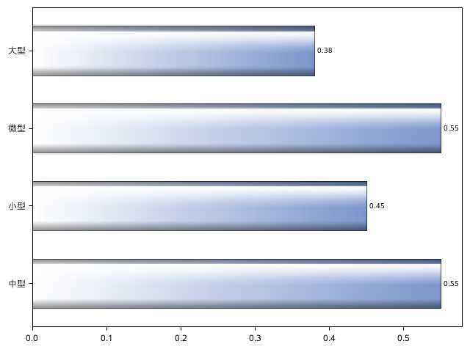
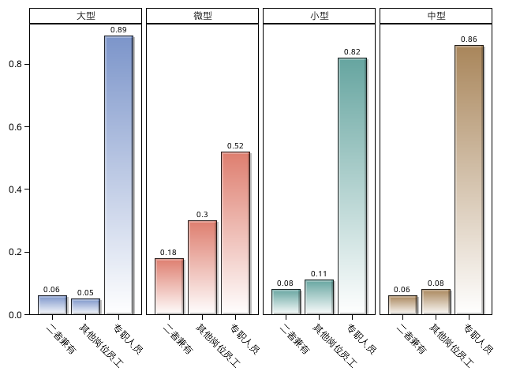
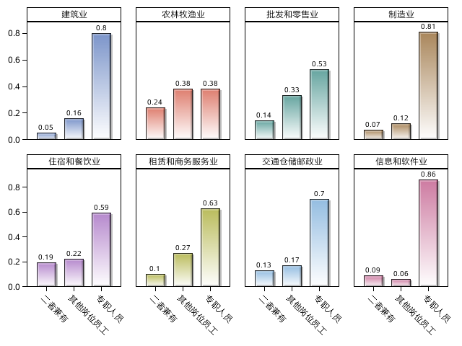
Financial management – alignment with standardized and professional practices
Use bookkeeping service
Employ finance and accounting personnel
Large
Large
Micro
Small
Medium
Micro
Small
Medium
Construction
Agriculture, Forestry, Husbandry & Fishery
Wholesaling & Retailing
Manufacturing
Both
Other employees
Dedicated personnel
Both
Other employees
Dedicated personnel
Both
Other employees
Dedicated personnel
Both
Other employees
Dedicated personnel
Accommodation & Catering
Leasing & Business Services
Transportation, Warehousing & Postal
IT & Software
Both
Other employees
Both
Other employees
Both
Other employees
Both
Other employees
Dedicated personnel
Dedicated personnel
Dedicated personnel
Dedicated personnel

Slide 36
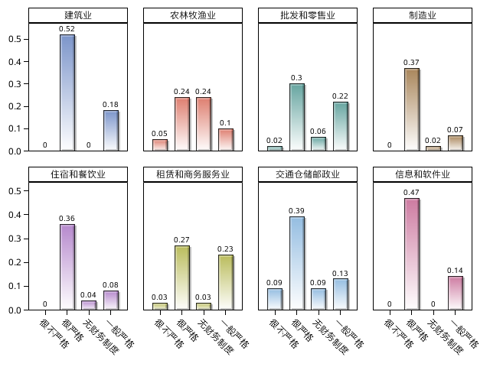
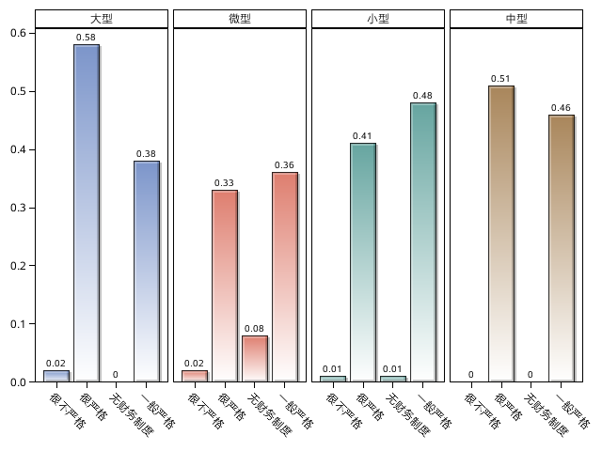
Implementation of financial system
Construction
Agriculture, Forestry, Husbandry & Fishery
Wholesaling & Retailing
Manufacturing
Large
Micro
Small
Medium
Accommodation & Catering
Leasing & Business Services
Transportation, Warehousing & Postal
Transport, Warehousing & Postal
IT & Software
Very strict
Very strict
None
Very strict
Very strict
Strict
Not very strict
None
Not very strict
Not very strict
None
Not very strict
None
Strict
Strict
Strict
Very strict
Strict
Very strict
Very strict
Very strict
Strict
Not very strict
Not very strict
None
Not very strict
Strict
Not very strict
None
Strict
None
None

Slide 37
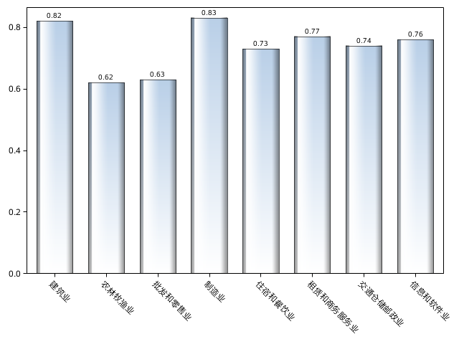
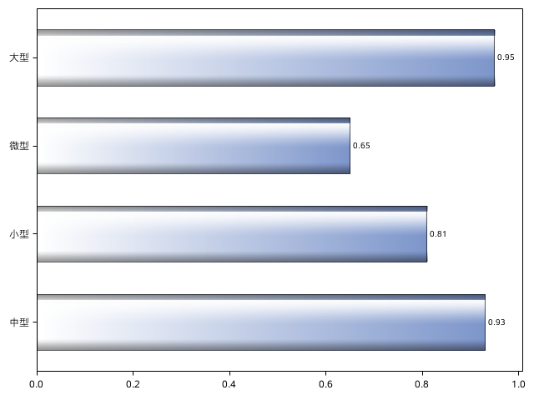
Budgeting
Large
Micro
Small
Medium
Construction
Agriculture, Forestry, Husbandry & Fishery
Wholesaling & Retailing
Manufacturing
Accommodation & Catering
Leasing & Business Services
Transportation, Warehousing & Postal
IT & Software

Slide 38
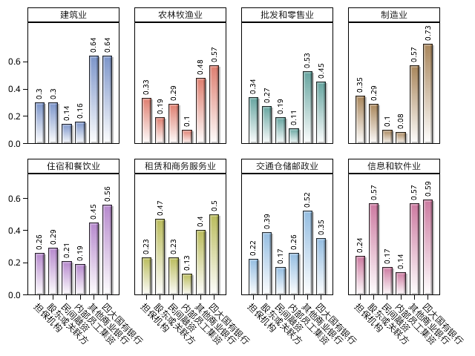
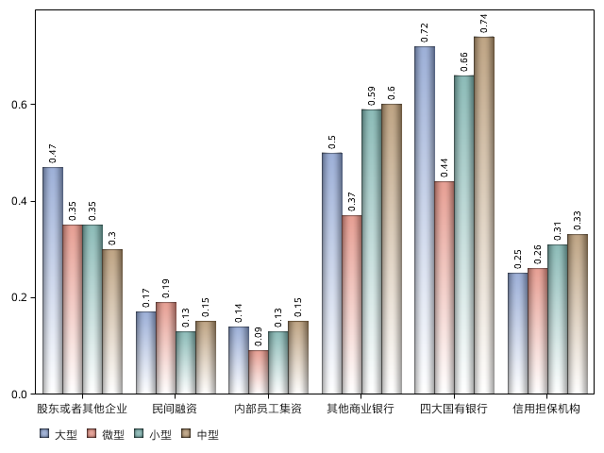
Financial management: fundraising
Channels
Construction
Agriculture, Forestry, Husbandry & Fishery
Wholesaling & Retailing
Manufacturing
Accommodation & Catering
Leasing & Business Services
Transportation, Warehousing & Postal
IT & Software
Big Four
Big Four
Big Four
Big Four
Shareholders/other companies
Private financing
Employees
Other commercial banks
Big Four
Credit guarantee institutions
Employees
Employees
Employees
Employees
Other commercial banks
Other commercial banks
Other commercial banks
Other commercial banks
Informal financing
Informal financing
Informal financing
Informal financing
Credit guarantee institutions
Credit guarantee institutions
Credit guarantee institutions
Credit guarantee institutions
Large
Micro
Small
Medium
Shareholders/other companies
Shareholders/other companies
Shareholders/other companies
Shareholders/other companies

Slide 39
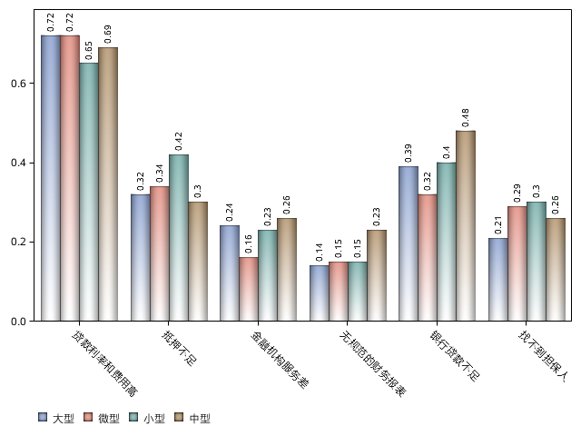
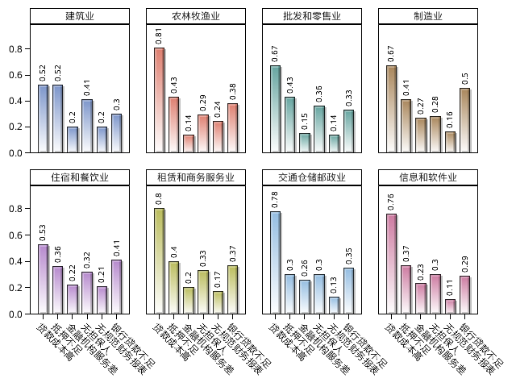
Financial management: fundraising
Restrictions
Construction
Agriculture, Forestry, Husbandry & Fishery
Wholesaling & Retailing
Manufacturing
Accommodation & Catering
Leasing & Business Services
Transportation, Warehousing & Postal
IT & Software
High rates and fees
Lack of collateral
Poor service
No standardized financial statement
Low line of credit
No guarantor
Large
Micro
Small
Medium
Lack of collateral
Low line of credit
Lack of collateral
Low line of credit
Low line of credit
Lack of collateral
Low line of credit
High rates and fees
High rates and fees
Lack of collateral
High rates and fees
No standardized financial statement
Poor service
High rates and fees
Poor service
No standardized financial statement
Poor service
No standardized financial statement
No guarantor
No guarantor
No standardized financial statement
No guarantor
Poor service
No guarantor

Slide 40
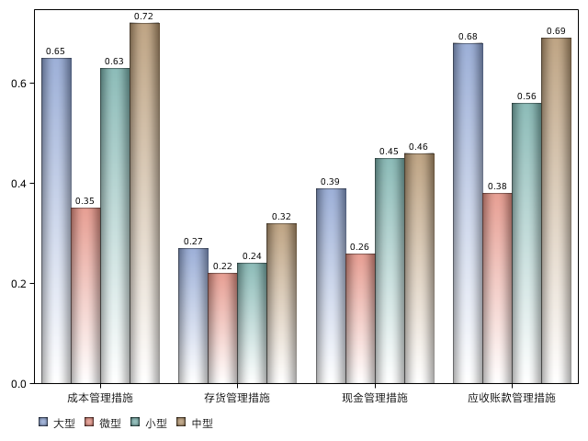
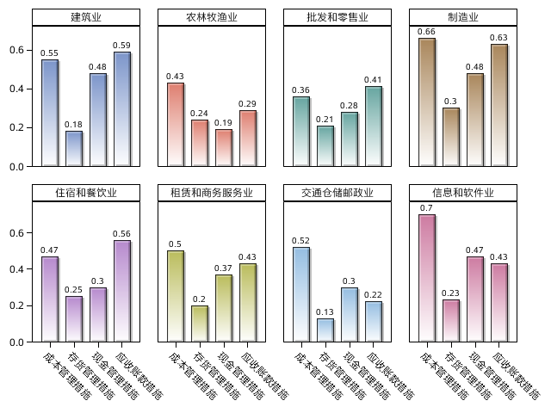
Financial management: working capital
Construction
Agriculture, Forestry, Husbandry & Fishery
Wholesaling & Retailing
Manufacturing
Accommodation & Catering
Leasing & Business Services
Transportation, Warehousing & Postal
IT & Software
Cost management
Inventory management
Cash management
Accounts receivable management
Accounts receivable management
Accounts receivable management
Accounts receivable management
Accounts receivable management
Large
Micro
Small
Medium
Cost management
Cash management
Cost management
Cash management
Cost management
Cash management
Cost management
Inventory management
Inventory management
Inventory management
Inventory management
Cash management
Zhejiang Guangxi Beijing Anhui
Guang
dong
Sichuan Jiangsu Shanghai
Fujian Shandong Jiangxi Liaoning Hubei Shaanxi Hebei Henan Chongqing Hunan Inner Mongolia

Slide 41
Digital management: inventory
Large
Medium
Small
Micro
A. Paper-based
B. Input data into a computer and organize manually
C. Input and organize data with software (e.g. ERP system)
D. Other
 | Paper-based | Input data into a computer and organize manually | Input and organize data with software (e.g. ERP system)
1. Information Transfer, Software & IT Services | 8.57 | 30 | 60
2. Manufacturing | 15.24 | 36.19 | 46.19
3. Construction | 17.78 | 46.67 | 35.56
4. Transportation, Warehousing & Postal | 13.04 | 39.13 | 30.43
5. Accommodation & Catering | 29.87 | 41.56 | 25.97
6. Wholesaling & Retailing | 37.04 | 37.78 | 20.74
7. Leasing & Business Services | 16.67 | 60 | 20
8. Agriculture, Forestry, Husbandry & Fishery | 56.52 | 34.78 | 4.35

Slide 42
Digital management: production/work process, process monitoring and client demand
Large
Medium
Small
Micro
A. By experience
B. Manage manually at regular intervals (subject to incoming orders)
C. Manage with software (subject to incoming orders)
D. Other
Large
Medium
Small
Micro
A. Learn from experience
B. Learn from the latest customer feedback
Large
Medium
Small
Micro
C. Analyze past sales data and market sales data
A. Onsite manual check
B. Remote manual monitoring
C. Real-time monitoring with software
D. Other
D. Other

Slide 43
Digital management: use of electronic management system
Large
Medium
Small
Micro
A. Production management system
B. Accounting management system
C. HR management system
D. Office automation
E. Other
F. No usage
Large
Medium
Small
Micro
Small
Micro
A. Reduce labor cost
B. Price is acceptable
C. Improve efficiency
D. Required by government or industry associations
A. Not need to use
E. Required by upstream or downstream companies
F. It works well in other companies
B. It’s expensive
G. Other
C. We don’t know how to use it

Slide 44
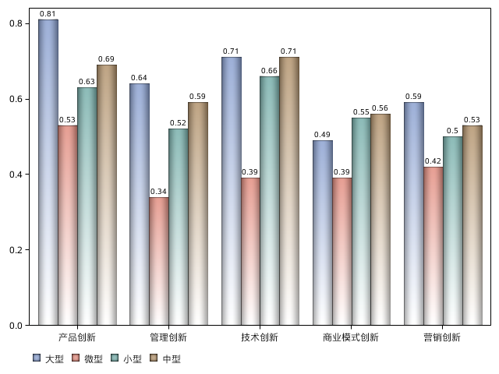
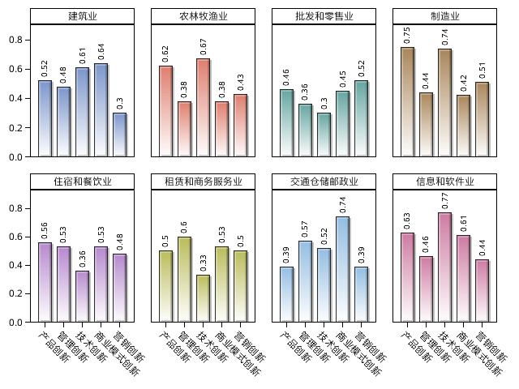
IV. Evaluation of and empowerment in innovation capabilities
Areas of business innovation and importance
Construction
Agriculture, Forestry, Husbandry & Fishery
Wholesaling & Retailing
Construction
Manufacturing
Accommodation & Catering
Leasing & Business Services
Transportation, Warehousing & Postal
IT & Software
Product
Management
Technology
Business model
Marketing
Large
Micro
Small
Medium
Marketing
Marketing
Marketing
Marketing
Business model
Business model
Business model
Technology
Technology
Business model
Technology
Technology
Product
Product
Product
Management
Management
Product
Management
Management

Slide 45
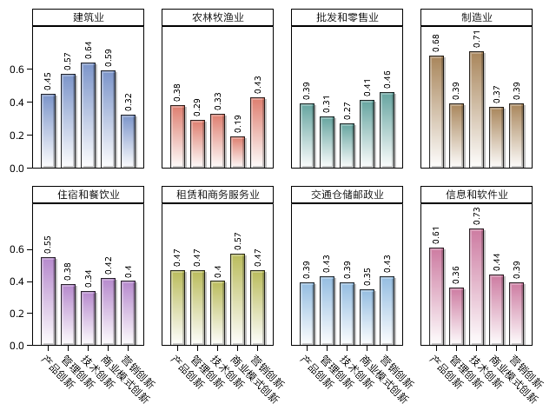
Innovation output
Product
Technology
Business model
Management
Marketing
Large
Medium
Small
Micro
Construction
Agriculture, Forestry, Husbandry & Fishery
Wholesaling & Retailing
Manufacturing
Construction
Accommodation & Catering
Leasing & Business Services
Transportation, Warehousing & Postal
IT & Software
Marketing
Marketing
Marketing
Marketing
Business model
Business model
Business model
Technology
Technology
Business model
Technology
Technology
Product
Product
Product
Management
Management
Product
Management
Management

Slide 46
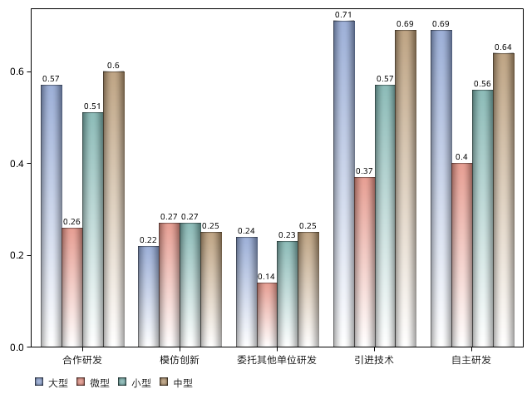
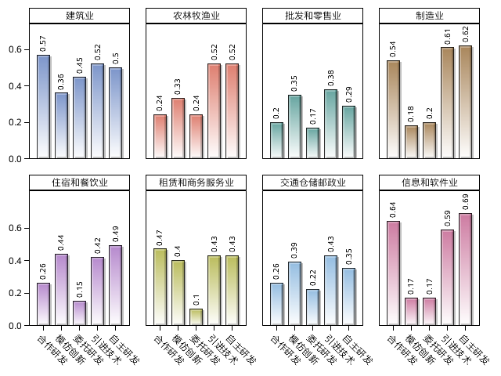
Approaches to innovation
Manufacturers and IT companies usually conduct independent R&D and introduce new technologies.
In other industries, companies tend to imitate other innovators
Construction
Agriculture, Forestry, Husbandry & Fishery
Wholesaling & Retailing
Manufacturing
R&D cooperation
Imitation
Commissioned R&D
Technology introduction
Independent R&D
Large
Micro
Small
Medium
Accommodation & Catering
Leasing & Commercial Service
Transportation, Warehousing & Postal
IT & Software
Imitation
Technology introduction
Imitation
Technology introduction
Imitation
Imitation
Independent
Independent
Technology introduction
Technology introduction
Commissioned
Commissioned
Independent
Independent
R&D cooperation
Commissioned
Commissioned
R&D cooperation
R&D cooperation
R&D cooperation

Slide 47
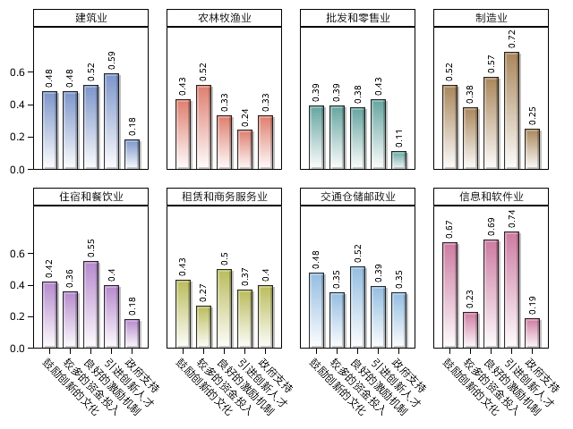
Drivers of innovation success
Innovative People
Incentive scheme
Culture of innovation
Large
Medium
Small
Micro
Strong financial support
Innovative people
Good incentive scheme
Innovation culture and environment
Government support
Construction
Agriculture, Forestry, Husbandry & Fishery
Wholesaling & Retailing
Manufacturing
Accommodation & Catering
Leasing & Business Services
Transportation, Warehousing & Postal
IT & Software
Government support
Government support
Government support
Government support
Innovative people
Innovative people
Innovative people
Incentive scheme
Innovative people
Incentive scheme
Incentive scheme
Innovation culture
Incentive scheme
Innovation culture
Innovation culture
Strong financial support
Innovation culture
Strong financial support
Strong financial support
Strong financial support

Slide 48
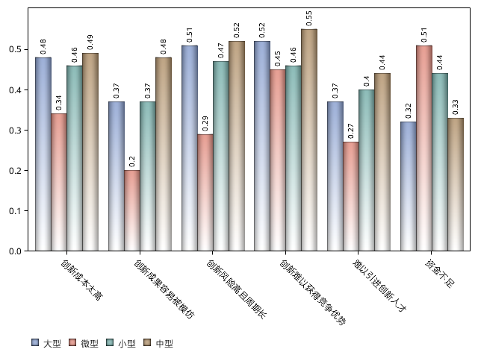
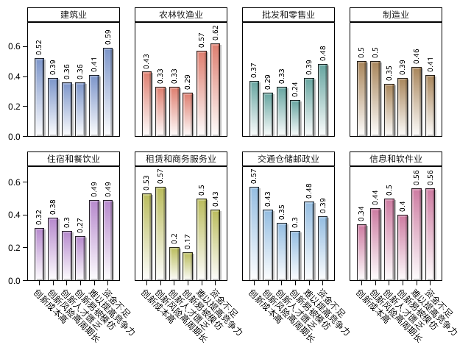
Factors hindering innovation
Construction
Agriculture, Forestry, Husbandry & Fishery
Wholesaling & Retailing
Manufacturing
Cost too high
Easily copied by others
High-risk and time-consuming
Hard to find innovative people
Shortage of funds
Does not translate into competitive advantage
Large
Micro
Small
Medium
Accommodation & Catering
Leasing & Commercial Service
Transportation, Warehousing & Postal
IT & Software
Shortage of funds
Shortage of funds
Shortage of funds
Shortage of funds
High cost
High cost
High cost
Does not enhance competitiveness
Does not enhance competitiveness
Does not enhance competitiveness
Talent shortage
Talent shortage
Talent shortage
High cost
Does not enhance competitiveness
Easily copied by others
Easily copied by others
Talent shortage
Easily copied by others
High-risk and time-consuming
High-risk and time-consuming
Easily copied by others
High-risk and time-consuming
High-risk and time-consuming

Slide 49
V. Demands for empowerment
Prefer: Digital management
Marketing
Do not prefer: Accounting & internal audit
Overall preferences for content of empowerment
7% of micro enterprises have no demands for empowerment
Large
Medium
Small
Micro
A. Digital operation & mgmt
B. Strategic decision making
C. Marketing
F. Tax planning
C. Marketing
D. Organizational structure & HR management
G. Financing & investment
A. Digital operation & mgmt
H. None of the above
B. Strategic decision making
E. Accounting & internal audit
E. Accounting & internal audit
F. Tax planning
D. Organizational structure & HR management
G. Financing & investment
H. None of the above

Slide 50
 | Digital operation & mgmt | Strategic decision making | Marketing | Organizational structure & HR mgmt | Accounting & internal audit | Tax planning | Financing & investment | None of the above
1. Information Transfer, Software & IT Services | 73% | 74% | 80% | 71% | 59% | 54% | 64% | 1%
2. Manufacturing | 71% | 74% | 77% | 63% | 59% | 50% | 56% | 1%
3. Accommodation & Catering | 57% | 60% | 68% | 56% | 44% | 42% | 53% | 3%
4. Transportation, Warehousing & Postal | 64% | 64% | 59% | 59% | 45% | 41% | 45% | 5%
5. Construction | 56% | 64% | 58% | 53% | 44% | 40% | 27% | 7%
6. Wholesaling & Retailing | 50% | 50% | 71% | 50% | 36% | 34% | 44% | 9%
7. Agriculture, Forestry, Husbandry & Fishery | 52% | 48% | 65% | 48% | 43% | 30% | 43% | 17%
8. Leasing & Business Services | 53% | 57% | 60% | 57% | 40% | 27% | 37% | 3%

Slide 51
Preference for content of empowerment: different categories
Large
Medium
Small
Micro
Large
Medium
Small
Micro
A. Effective management structure
B. How to manage branches
A. Digital transformation of traditional business modes
B. Information-based management
C. None of the above
C. How to motivate bottom-level employees
D. How to manage mid & high-level employees
Large
Medium
Small
Micro
Large
Medium
Small
Micro
A. Learn bookkeeping
B. Learn basics of cost accounting
A. Analyze impacts of economic indicators and major events on company
C. Learn accounting software quickly
D. Design internal audit scheme to prevent management risks
B. How to obtain more information
E. Other
C. Find a better decision making process
Large
Medium
Small
Micro
Large
Medium
Small
Micro
A. Identify client demands in a timely manner
B. Channel expansion
A. How to raise more money
B. How to control debt risk
C. How to management cash and account receivables
C. Increase sales online
D. Customer retention
D. Learn more about insurance and investment products
E. Other
E. Other

Slide 52
Preference for methods of empowerment
In-class training + learn from other companies
Large
Medium
Small
Micro
A. Online/offline in-class training
B. Visit and learn from other companies
C. Consult experts
D. Talk to family and friends
E. Read books
F. Other

Slide 53
VI. Conclusion
Who needs to be empowered?
  Micro, small and medium-sized enterprises
  SMEs are more concerned with empowerment than micro enterprises
  Be aware of differences in company size, industry and region
Reasons:
Form of business: most micro enterprises operate in the form of self-employed traders (61.28%);
Industry: many small enterprises are manufacturers (38.18%), and many micro enterprises operate in wholesaling and retailing (33.83%) or the accommodation & catering industry. Industry characteristics concerning management and innovation greatly influence the demands for empowerment of small and micro enterprises.

Slide 54
Content of empowerment
      SMEs have stronger management and innovation capabilities -> their demands are similar to those of large enterprises
      Demands of MSEs in manufacturing, IT & software and construction are similar to those of large enterprises
      Demands of MSEs in economically developed regions are similar to those of large enterprises

Slide 55
Overview of demands for management empowerment
Top demands | Medium | Small | Micro
Top four demands for empowerment | Strategic decision making Digital management Marketing Organizational structure & HR management | Strategic decision making Digital management Marketing Organizational structure & HR management | Marketing Digital management Strategic decision making Organizational structure & HR management
Digital operation & management | Information-based management | Information-based management | Digital transformation of traditional business modes
Strategic decision making | Analyze impacts of economic indicators and major events on company | Analyze impacts of economic indicators and major events on company | Analyze impacts of economic indicators and major events on company
Marketing | Identify client demands in a timely manner | Identify client demands in a timely manner | Identify client demands in a timely manner
Organizational structure & HR management | Effective management structure Incentives for executives and bottom-level employees | Effective management structure Incentives for executives and bottom-level employees | Effective management structure Incentives for bottom-level employees
Accounting & internal audit | Improve internal audit scheme | Improve internal audit scheme | Learn bookkeeping
Financing & investment | Lower debt risk | Lower debt risk | How to raise more money

Slide 56
Summary of demands for innovation empowerment
Priority for innovation empowerment:
Raise MSMEs’ awareness of the challenges to their survival
Strengthen their motivations for innovation by providing successful examples
  Enterprises put much emphasis on innovation-capable human resources and sound incentive mechanisms rather than government support
  MSMEs’ top three concerns are: difficulty to gain a competitive advantage through innovation; innovation is risky and takes a long time to realize commercial value; and high cost, coupled with the shortage of human resources and funds. Their biggest worry is losing more than they could gain

Slide 57
How to empower them?
  Online/offline in-class training
  Visit and learn from other companies
  Consult experts
Organizations and methods
  Experts retired from universities
  and companies
  Industry associations
  Nonprofit organizations
  Business organizations
  Leverage mobile internet
Government support

Slide 58
Limitations
  Did not consider the influence of culture and mission on corporate development
  Data analysis could go deeper
  Certain dimensions of questionnaire design could be improved

Slide 59
Acknowledgements
We would like to thank:
Visa China for funding and supporting the study
SME Development Association of Henan Province, CFPA Microfinance and Grassland Microfinance Association for their strong support
All experts for their cooperation

Slide 60

Thank
You
Address: Mingde Business Building, Renmin University of China, Haidian District, Beijing
TEL:
Email:
Website: http://www.rmbs.ruc.edu.cn

